Slide 1
RESEARCH ON MARINE PLASTICS
IN SOUTHEAST ASIA:
Who does what?
17- 18 June 2019
COBSEA WG Marine Litter-3 , Bali
Youna Lyons, Centre for International Law, NUS
(younalyons@nus.edu.sg)

Slide 2
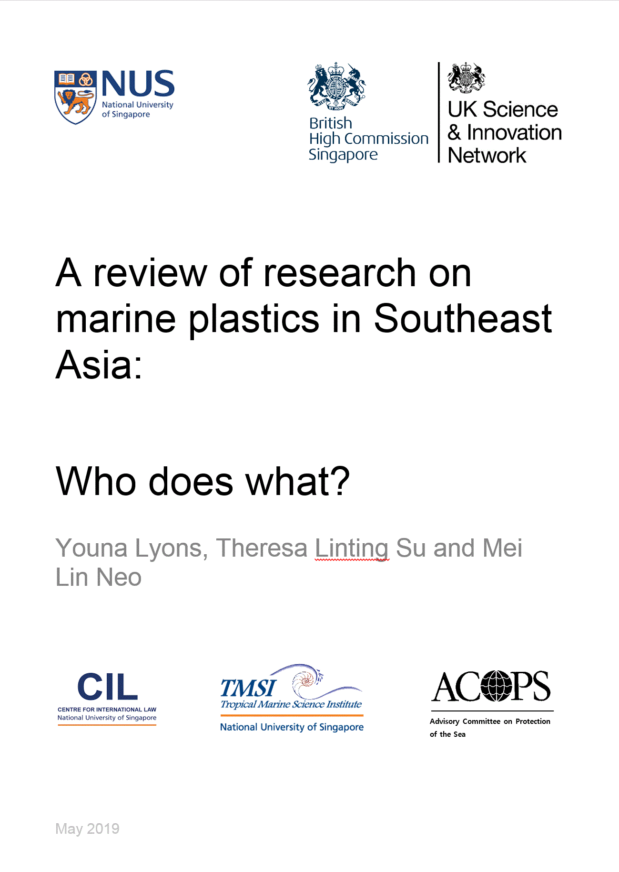

Slide 3
Background and Scope
Natural evolution of on-going work of NUS on different aspects of marine plastics in the region
Focus on research in natural sciences and programmes and initiatives that involve governments in the region, directly or indirectly – Little socio-economic analysis involving the private sector
Funding from the United Kingdom
The information contained in this version 1 is true as off 15 May 2019. We hope to continue the work in a version 2 that would be updated, more comprehensive and built-in comments from the region

Slide 4
Methodology and Structure
Research based on systematic review of published scientific literature, internet research with a series of keywords and authors work in different programmes on this topic including participation to working groups at the IMO (Marine Environmental Protection Committee, PPR, London Convention/London Protocol).
Part 1- Marine plastic research in each ASEAN Member State
Context, status of understanding, main players, gaps, events hosted
Part 2- Programmes/initiatives in regional bodies: ASEAN, COBSEA, etc.
Part 3- Global frameworks relevant to Southeast Asia
Part 4- Notable partnerships (incl. public-private)
Part 5- Comparative analysis

Slide 5
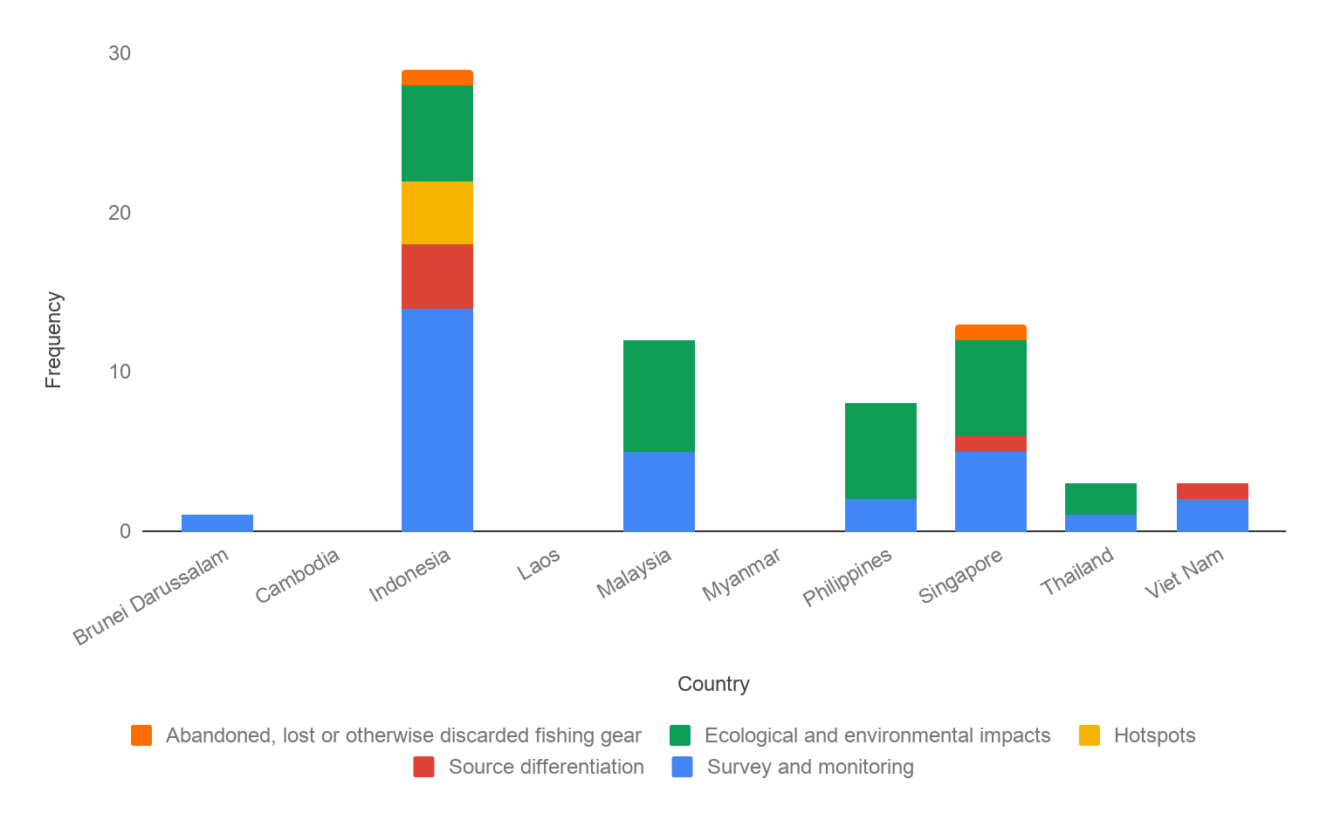
Findings in natural sciences
Areas of research: survey and monitoring, source differentiation, hotspots, ecological and environmental impacts, ALDFG

Slide 6
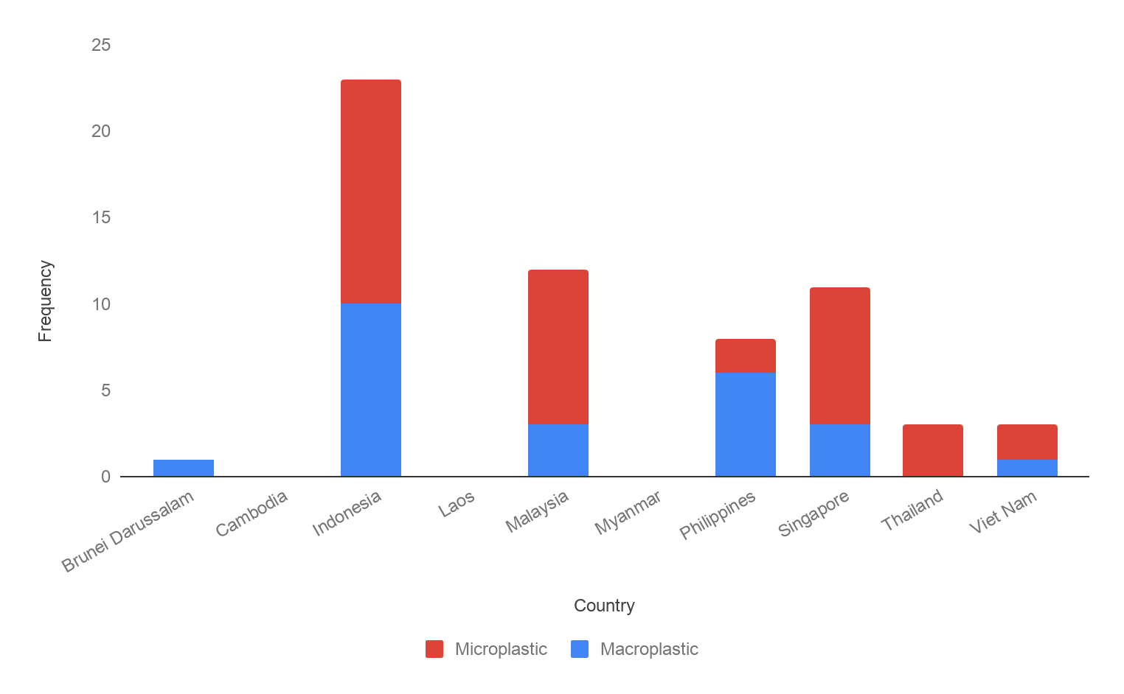
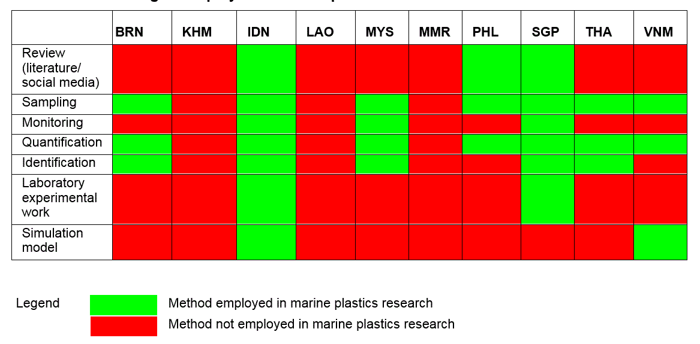
Findings in natural sciences

Slide 7
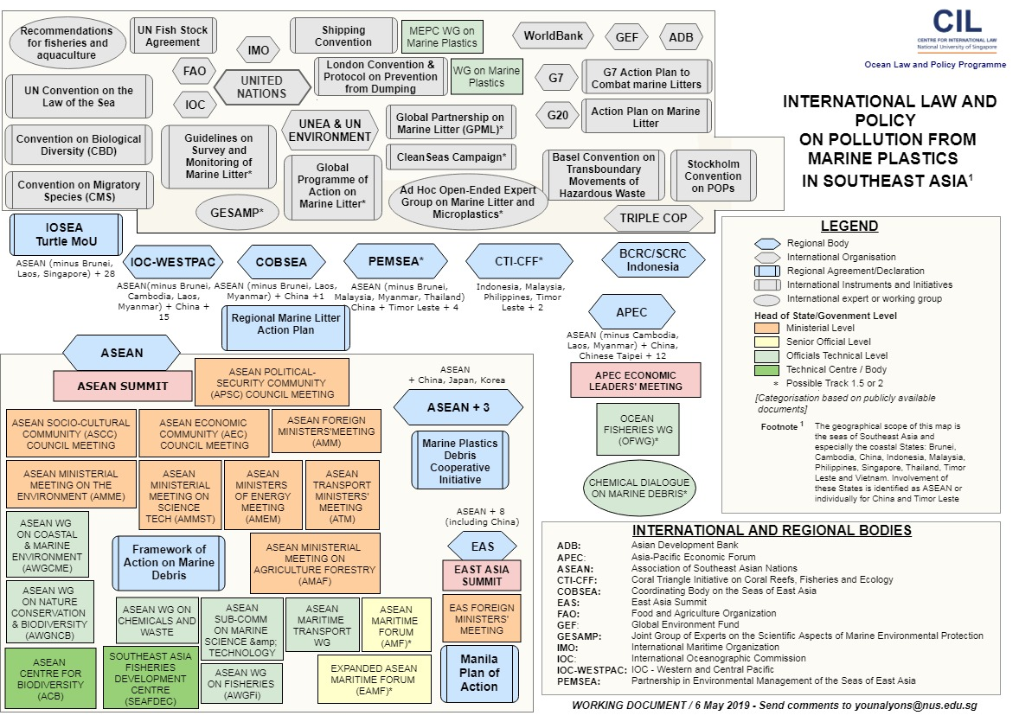
Findings in review of work by regional and global bodies and initiatives

Slide 8
Findings in the work of regional and global bodies and initiatives
20
Research Topics
Identified
- policy, laws, administrative measures
- Action Plans, guidelines and standards
- Public outreach/beach clean-up
- Language and cultural barriers, data accessibility
- Upstream research/circular economy
- Research framework, coordination
Survey and monitoring/pollution status
Methodology for monitoring and assessment
Source differentiation,
Contribution of fisheries
Contribution from offshore activities
Accumulation zones
Ecological and environmental impact
Microplastics, etc

Slide 9
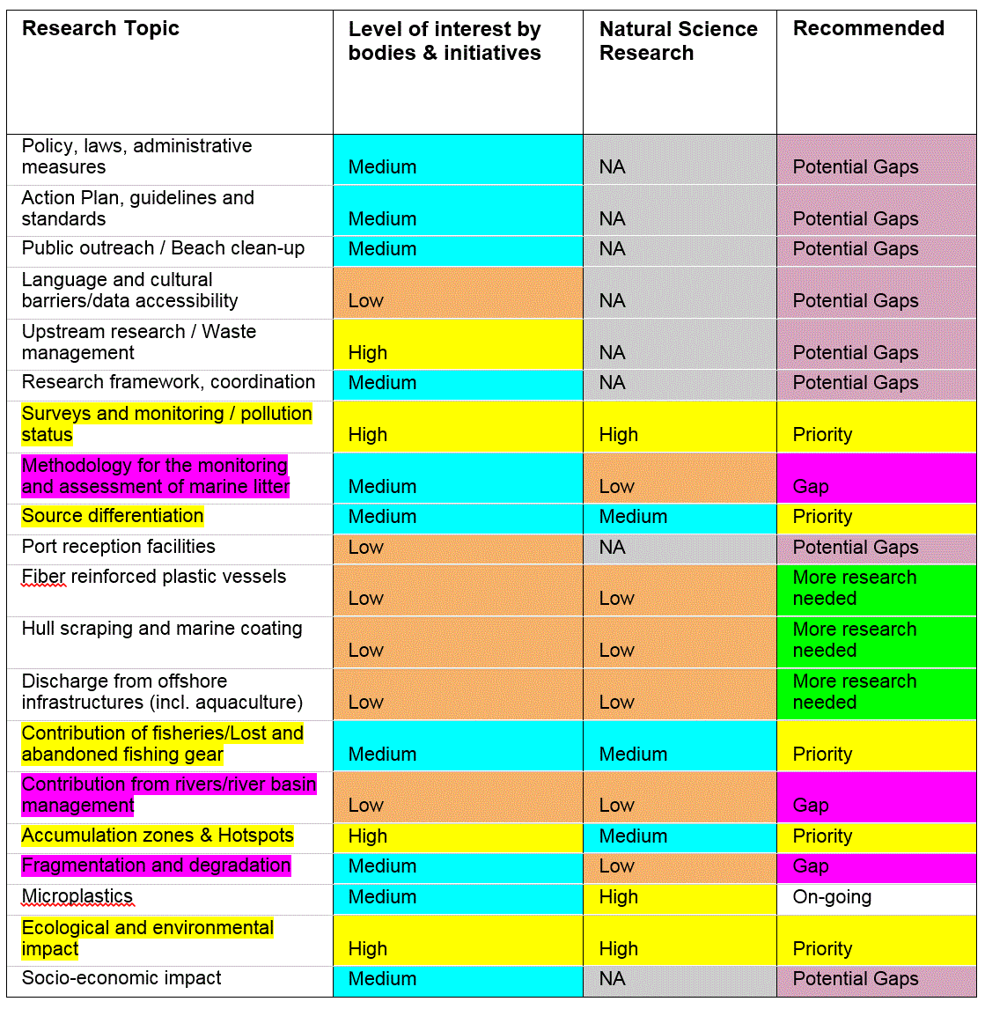
Comparative analysis

Slide 10
Gaps and Priorities
Research priorities:
Surveys and monitoring
Source differentiation
Accumulation zones & hotspots
Ecological and environmental impact
Contribution of fisheries/lost and abandoned fishing gear
Gaps in research:
Methodology for the monitoring and assessment of marine litter
Contribution from rivers/river basin management
Fragmentation and degradation
Issues related to the deliberate or abandonment of waste at sea
Risk assessment approach to prioritization
Consider also potential gaps in research

Slide 11
How
In addition to needed research and grants administered in the region,
Improve coordination at regional level
[All three SDs & several actions in the AP esp. Action 4 ]
Develop a network of regional institutions/research centres that play a complementary role – could be based on on-going programmes to harvest existing know-how
Regional knowledge management platform that links existing work to assist stakeholders in the region
Flow of information: Consider ways to engage local communities in effort and developing discussion groups or information forum to break the silos

